Slide 1
Overview of Database

Slide 2
A database is an organized collection of data. The data are typically organized to model relevant aspects of reality in a way that supports processes requiring this information. For example, modeling the availability of rooms in hotels in a way that supports finding a hotel with vacancies.
Database management systems (DBMSs) are specially designed software applications that interact with the user, other applications, and the database itself to capture and analyze data. A general-purpose DBMS is a software system designed to allow the definition, creation, querying, update, and administration of databases. Well-known DBMSs include MySQL, MariaDB, PostgreSQL, SQLite, Microsoft SQL Server, Oracle, SAP HANA, dBASE, FoxPro, IBM DB2, LibreOffice Base and FileMaker Pro. A database is not generally portable across different DBMSs, but different DBMSs can interoperate by using standards such as SQL and ODBC or JDBC to allow a single application to work with more than one database.

Slide 3
Basics about a database ?
A database is a structured collection of records.
Database Management System ( DBMS )
add, remove, update records
retrieve data that match certain criteria
cross reference data in different tables
perform complex aggregate calculation
Database consists of columns (attributes) and rows (records).

Slide 4
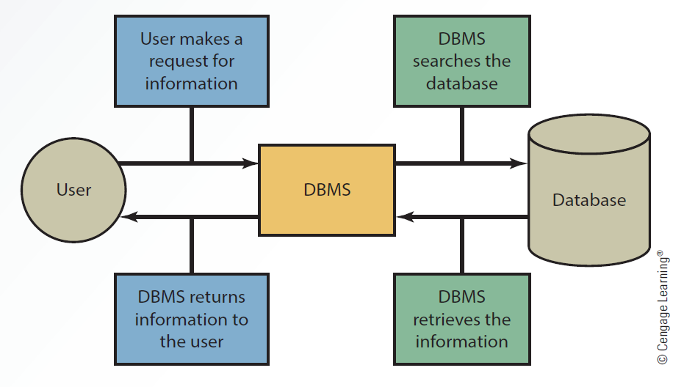
Interaction Between the User, DBMS and Database

Slide 5
Single OR Multiple table ?

Slide 6
Disadvantages of a single table database
Redundancy of data
• Problem with complex data
• Problems in updating in bulk (new phone number)
• Problems in adding incomplete data (new publisher)
• Problems in removing group of data (all books from the publisher)
Solution:
Relational Database Management System (RDBMS)

Slide 7
Relational Database
System of related tables
• Minimum redundancy
• Referential integrity
• Database keys
• The ACID model (guarantee of successful transactions):
–Atomicity („all or nothing” rule)
–Consistency (only valid data in)
–Isolation (order of executed transactions)
–Durability (committed transaction will not be lost)

Slide 8
Database keys
• Primary key
–Value unique for each record in a table
–This value can not be used twice
–AutoNumber guarantees uniqueness but does not carry any useful information
• Foreign keys
–Used to create relationships between tables
–No uniqueness constraint for foreign keys
• Relation between primary and foreign keys
–Same format
–Same values

Slide 9
Queries
• Database – data located in tables + relations
• Query – primary mechanism for retrieving information from a database, consists of questions presented to the database in a predefined format – an expression stored in a database having a unique name
• Answer to the query – a computed table = Dynaset
• SQL – Structured Query Language
• Types of queries:
– DML (Data Manipulation Language)
– DDL (Data Definition Language)

Slide 10
Database Normalization Basics
• Purpose :- eliminating redundant data
- ensuring logical relations of dependent data
• The normal forms
- 1NF, 2NF, 3NF, BCNF

Slide 11
Different SQL JOINs
Notes:
‹#›

Slide 12
INNER JOIN (Equi join) : Returns all rows when there is at least one match in BOTH tables
LEFT JOIN : Return all rows from the left table, and the matched rows from the right table.
RIGHT JOIN : Return all rows from the right table, and the matched rows from the left table
SELF JOIN : You use self join when you want to combine records with other records in the same table. To perform the self join operation, you must use a table alias to help MySQL distinguish the left table from the right table of the same table.
CROSS JOIN (Cartesian Product) : The CROSS JOIN produced a result set which is the product of rows of two associated tables when no WHERE clause is used with CROSS JOIN.

Slide 13


